Slide 1
NVIDIA TX Autonomous Vehicle
Name: Chan Ryu, Maximilian See
Matrix: 2101726D, 2102869A
Supervisor: Mr Tan Sio Poh

Slide 2
Background
We wanted to create an autonomous car that can recognise traffic signs and act accordingly. Our motivation was the robot in the AI Lab. However, we were not able to replicate in fully due to hardware differences such as the mapping system.

Slide 3
Targeted Users
Students
Pique their curiosity of AI Models
Show how what we are taught in school (deep learning and models) can be applied in physical device
With further improvements (Following a route on a map)
Companies who are interested to integrate autonomous robots
Stock Counting in warehouse via autonomous robot
Tray Return Robots
Simple Deliveries

Slide 4


Features
Image Recognition of Signs (Left/Right/Straight)

Slide 5
Existing Products
 | DonkeyCar | Our Robot
Price | ~$250 | ~$800
Hardware | Raspberry Pi + RC Car | Nvidia TX1 + Arduino + Polulu Board
Features | Follow Lane Lines | Image Recognition for Turn Signs
Notes:
opensource DIY self driving platform for small scale cars

Slide 6
System Architecture (Ryu)
Extract Weights
modelweights.npy
Train Tensorflow model
CreatingCaffe.py
Model Architecture
model.prototxt
model.caffemodel

Slide 7
System Architecture (Max)
ROS Master
Camera Node
Image Processing Node
Classifier
Node
Motor
Node
ROS Launch File
Publish
Subscribe
Camera
/usb_cam/image_raw

Slide 8

Assumptions
There will always be a sign in front of the robot
The robot is in a Lab settings
The sign will be upright
The sign will only be left or right turn

Slide 9
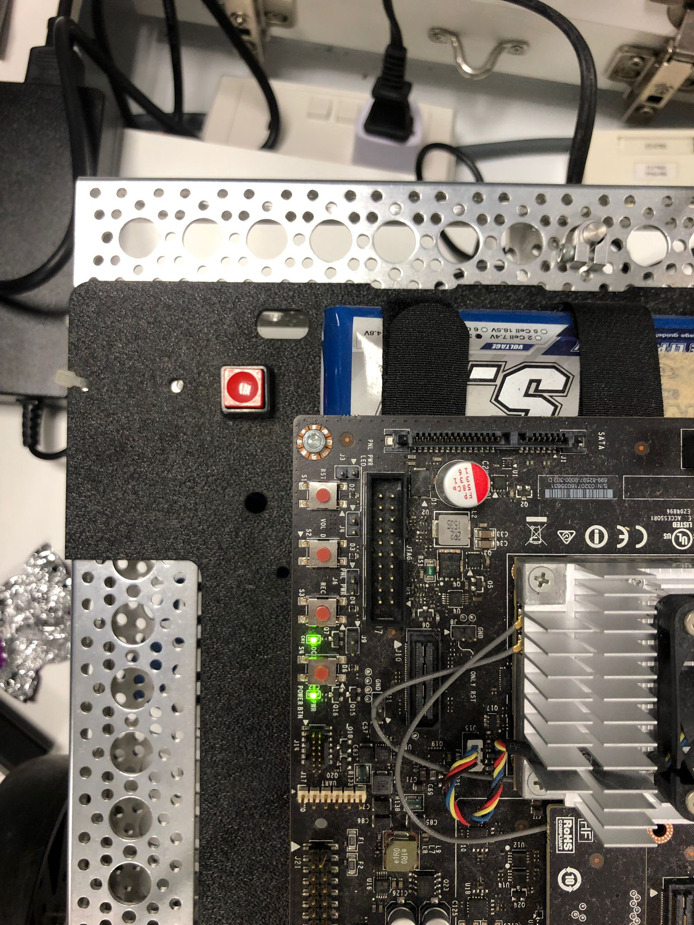
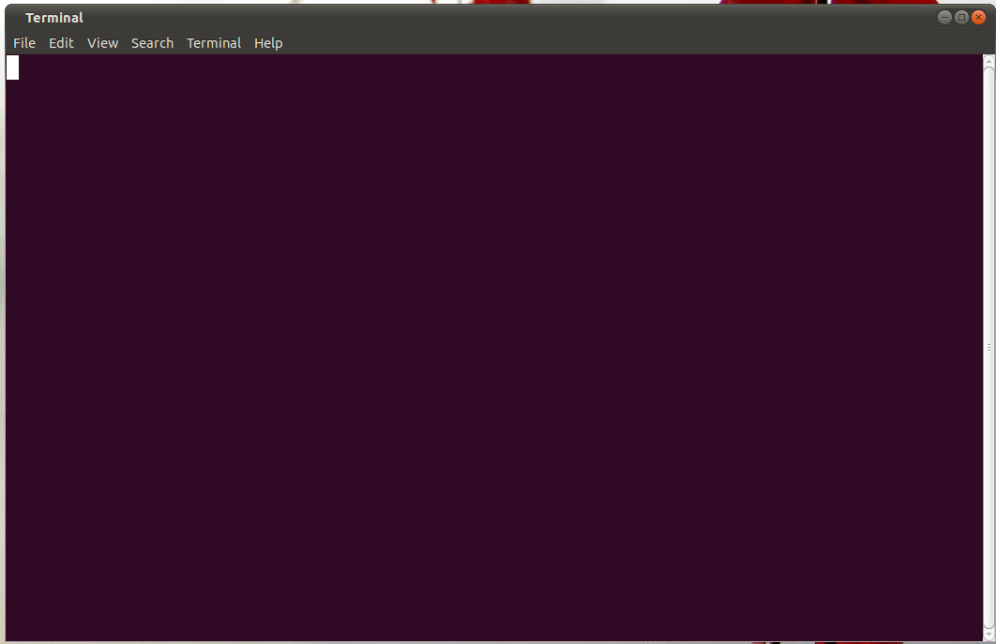

User Guide
sudo ssh nvidiatx1@192.168.1.116
cd catkin_ws/src/rosjet/lab4_autonomous_driving/launch
roslaunch lab4_inference.launch
Battery / Polulu board
TX1 Board
Left Turn Demo
Right Turn Demo
Notes:
Left : https://drive.google.com/file/d/1z7WvpAYG4Yf3dDtk9sK3PJoH1lpCoCP-/view?resourcekey
Right: https://drive.google.com/file/d/1z7WvpAYG4Yf3dDtk9sK3PJoH1lpCoCP-/view?resourcekey

Slide 10
Limitations
Resource Considerations:
Due to a lack of CPU, RAM and Storage resources in the robot, we had to scale down our model, and limit the complexity of them.
Hardware Restrictions:
Due to hardware restrictions such as the battery not working, it has to be connected to a power supply at all times. As such, it cannot travel very far in demos.
Security Issue:
Our development environment cannot use the internet due to security limitations on the school wifi. Without that we cannot deploy our code which was intended to send a video file of what the robot saw for data analysis to AWS .

Slide 11
Future Enhancement
Enhanced Camera Setup:
Integrate additional cameras to improve data capture for the robot.
Advanced Model Implementation:
Incorporate models like Behavioral Cloning or Reinforcement Learning to boost decision-making precision.
Optimal Hardware Upgrades:
Upgrade with LiDAR sensors to enhance environmental mapping and awareness.
Decision-Making:
Better cameras and models will aid the robot in making more informed choices.
Expanded Spatial Understanding:
LiDAR technology enables the robot to create comprehensive maps of its surroundings for improved navigation.

Slide 12
Challenges / Lessons Learnt
Navigating Unfamiliar Territory:
Adapting to a new product stack and hardware landscape, including ROS and CPP, presented a steep learning curve.
Unveiling Hardware Complexity:
The intricacies of hardware wiring and coding were initially foreign to our team.
Encountering Hardware Hurdles:
Overcoming obstacles like aged robot components leading to disruptions due to loose connections and wires.
Development Delays:
The presence of hardware issues led to development pauses, hindering progress.

Slide 13
Challenges / Lessons Learnt (personal)
Expect delays and prepare for them.
When starting this project, I started with the assumption that the hardware as well as software were working. This did not age well as there were multiple hardware and software issues. Thus. it’s better to read up on the past errors or problems one might encounter from forums, subreddits or Nvidia Documentation instead of preparing or learn to implement more complicated features.
Expect things out of your control and learn to make the most out of your time.
Time is not a commodity and making the most out of your time approaching the problem in a different way or learning a tool might pay off
Raise Persistent Issues Even if not Confident.
It's wiser to voice concerns about an issue rather than remain silent.

Slide 14
Thank You

